Slide 1
DePaul University
Feb 09, 2025
Group 4
Case Study 1

Slide 2
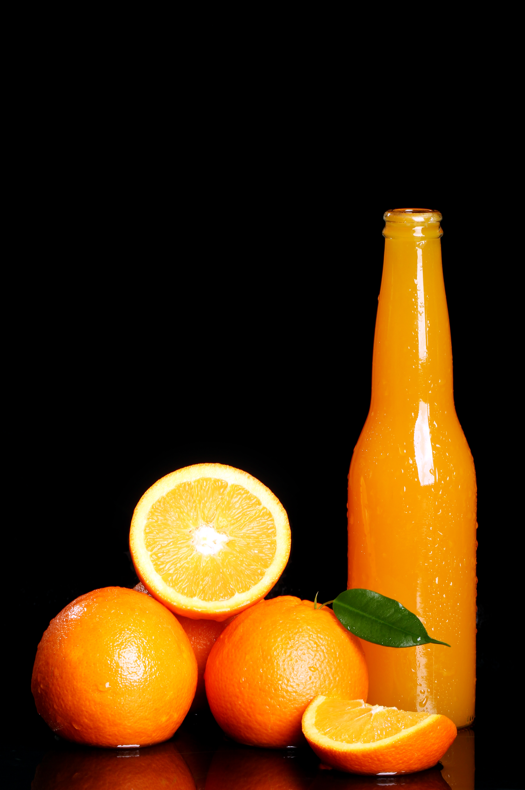
DePaul University
Feb 09, 2025
Walsh’s Juice Company aims to optimize the transportation of unprocessed grape juice from vineyards to processing plants and efficiently allocate production to minimize total costs, including transport and processing expenses.
W

Slide 3
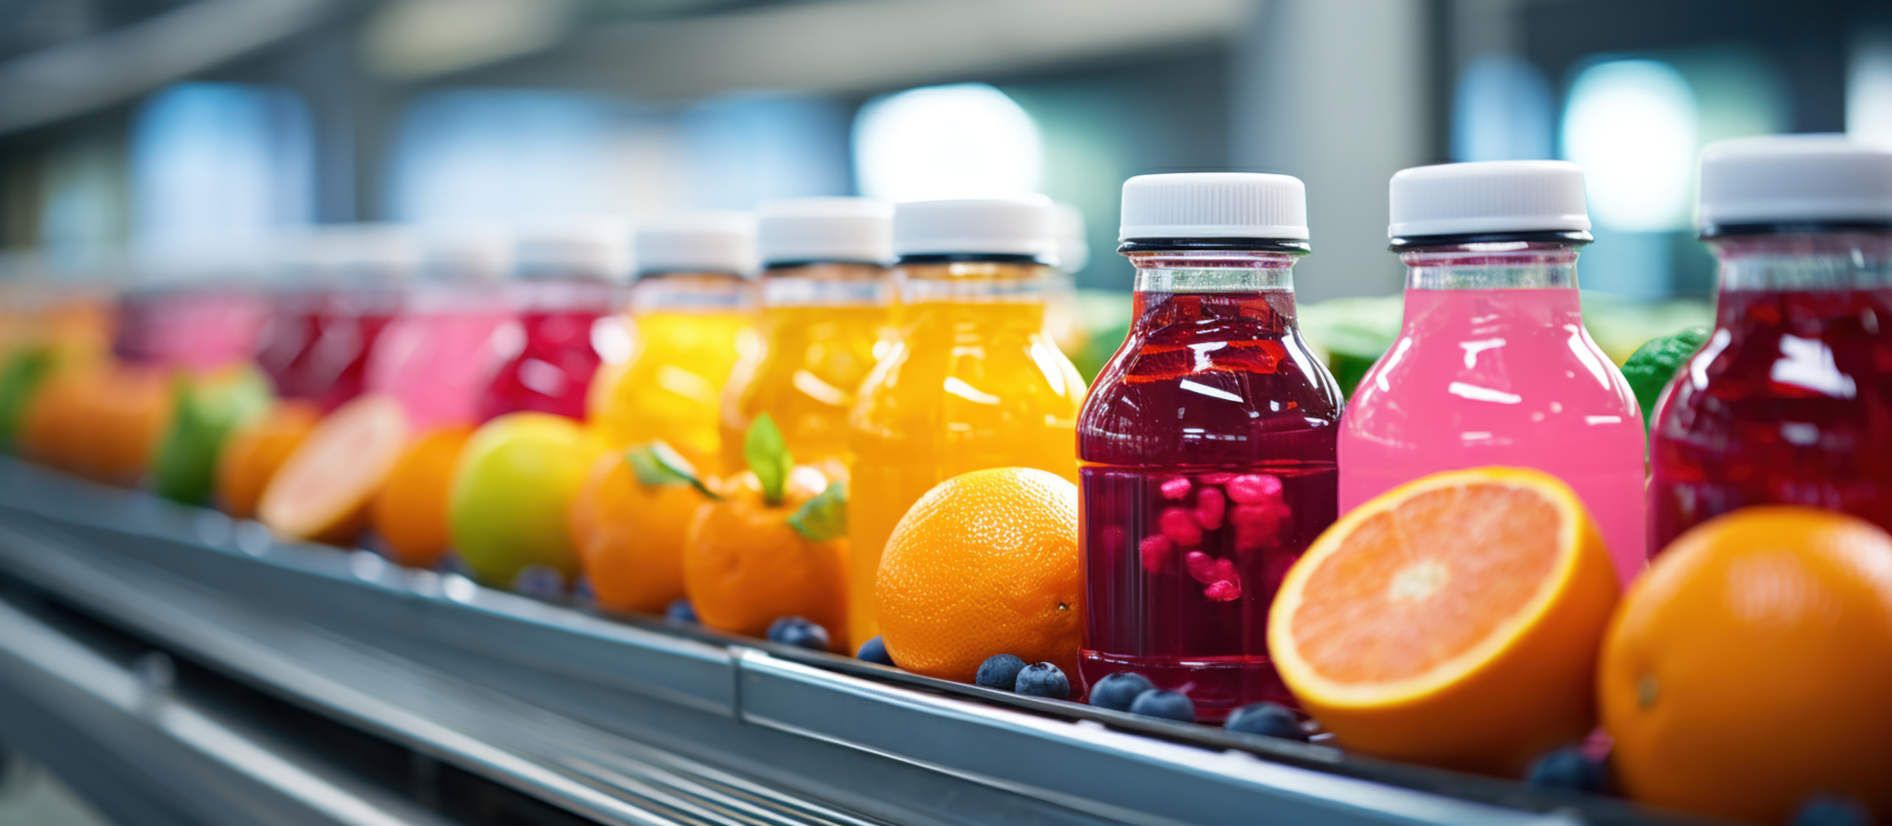
DePaul University
Feb 09, 2025
Summary of the Case Study
Walsh's Juice Company Overview:
They make three products: bottled juice, frozen juice concentrate, and jelly.
Grape Juice Supply:
New York: 1,400 tons available.
Pennsylvania: 1,100 tons available.
Ohio: 1,700 tons available.
Plant Capacity:
Virginia: Can process 1,200 tons.
Michigan: Can process 1,100 tons.
Tennessee: Can process 1,400 tons.
Indiana: Can process 1,400 tons.
Product Demand: Bottled Juice: Need 1,200 tons . ( 1200 tons of unprocessed juice )
Frozen Concentrate: Need 900 tons.( 1800 tons of unprocessed juice )
Jelly: Need 700 tons. (1050 tons of Jelly is required)

Slide 4
DePaul University
Feb 09, 2025
Summary of the Case Study
Transportation Costs:
It costs different amounts to move juice from the vineyards to each plant.
Processing Costs:
Each plant has different costs to make each product (juice, concentrate, and jelly) because of things like equipment, wages, etc.
Objective:
The company wants to minimize the total costs.
Constraints:
Limited grape juice available from each vineyard.
Each plant can only handle a certain amount of juice.
The company needs to make a certain amount of each product.

Slide 5
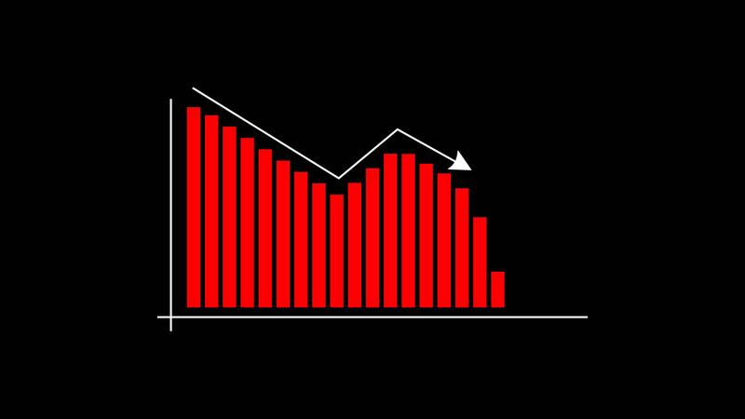
DePaul University
Feb 09, 2025
Objective and question
The goal is to reduce total costs for Walsh's Juice Company, including both the cost of transporting grape juice to the plants and the cost of processing it into bottled juice, concentrate, and jelly.
Questions to Answer:
How much grape juice should be sent from each vineyard to each plant to keep transport costs low?
How much of each product should be made at each plant to meet the demand at the lowest cost?
What is the total cost of production and transportation with the current setup?
Are there ways to cut costs by changing how we transport or produce the products?
How do the limits of juice supply and plant capacity affect the overall solution?

Slide 6

DePaul University
Feb 09, 2025
Model Description
Model Explanation:
We used a linear programming model to solve this problem because it helps us reduce costs while meeting the company’s needs.
Key Parts of the Model:
Decision Variables:
How much grape juice to send from each vineyard to each plant.
How much of each product (bottled juice, concentrate, jelly) to make at each plant.
Objective:
Minimize total costs, which include:
Transportation costs (moving juice from vineyards to plants).
Processing costs (turning juice into bottled juice, concentrate, or jelly).
Constraints:
Juice supply: Each vineyard only has a certain amount of juice.
Plant capacity: Each plant can only process so much juice.
Product demand: We need to produce specific amounts of bottled juice, concentrate, and jelly.
Processing requirements: Concentrate and jelly need extra juice because of water loss during production.

Slide 7

DePaul University
Feb 09, 2025
Model Description
Why This Model:
We chose this model because it helps us:
Reduce costs while making sure all plants and vineyards meet their limits. Handle multiple challenges like transportation, production, and cost in one clear system.
Key Assumptions:
Costs are constant for transportation and production.
No limit on transportation capacity between vineyards and plants.
Product demand won’t change, and we meet it exactly.
This model is simple, efficient, and helps minimize costs while keeping production and transport running smoothly.

Slide 8
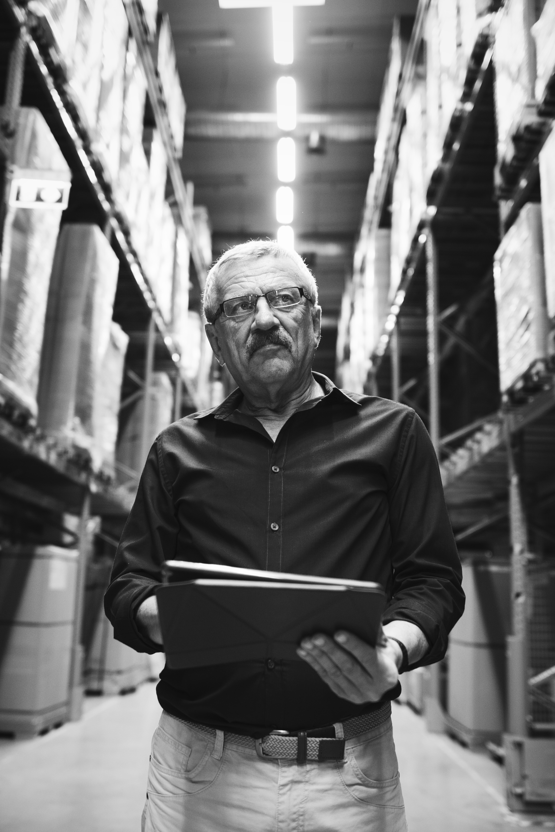
DePaul University
Feb 09, 2025
Analysis and Results
Analysis Overview
The main goal of this analysis was to minimize the overall transportation and processing costs for Walsh's Juice Company, ensuring that supply, demand, and capacity constraints were satisfied. We analyzed the transportation of raw materials from vineyards to processing plants and then calculated the costs for converting those materials into juice, concentrate, and jelly.
Techniques Used
We used Linear Programming (LP) to solve this problem because it involves multiple constraints (like supply limits, plant capacity, and demand requirements) and an objective function (minimizing total cost). LP helps optimize a linear objective function subject to linear equality and inequality constraints.

Slide 9

DePaul University
Feb 09, 2025
Analysis and Results
Why Linear Programming?
Multiple constraints: The model has to respect vineyard supply, plant capacities, and product demand.
Cost minimization: LP is ideal for minimizing transportation and processing costs.
Key Components:
Objective function: Minimize total transportation and processing costs.
Decision variables: Amount transported between vineyards and plants, and the amount processed at each plant.
Constraints:
The supply from vineyards cannot exceed the given limit.
Plant capacity must not be exceeded.
Each product's demand must be fully satisfied.
Results Summary
Total Costs:
The final solution resulted in a total cost of $10,606,000, which covers transportation and processing costs.
Transportation Solution:
We optimized the transportation of raw materials:
From New York to Indiana: 1400 units.
From Pennsylvania to Michigan: 1100 units.
From Ohio to Virginia and Tennessee: 150 and 1400 units, respectively.

Slide 10
DePaul University
Feb 09, 2025
Analysis and Results
We processed the products at the plants based on their capacity:
Juice: Processed entirely in Indiana (1200 units).
Concentrate: Spread across Virginia, Michigan, Tennessee, and Indiana.
Jelly: Processed in Michigan (700 units).

Slide 11

DePaul University
Feb 09, 2025
Conclusion and Recommendation
Recommended Actions 1
Optimize Transportation Routes:
Focus on Indiana: Indiana handles a large amount of shipments. We should explore if redirecting some shipments to other plants can reduce costs.
Review Ohio Shipments: Ohio splits its supply between Tennessee and Indiana. We should explore if sending all shipments to one plant could be more efficient.
Adjust Processing Allocations:
Increase Usage of Michigan: Michigan is not being fully used for juice production. By utilizing Michigan more, we can balance the workload and possibly reduce costs.
Redistribute Jelly Production: Currently, all jelly is processed in Michigan. Processing some in other plants may reduce costs and delays.

Slide 12
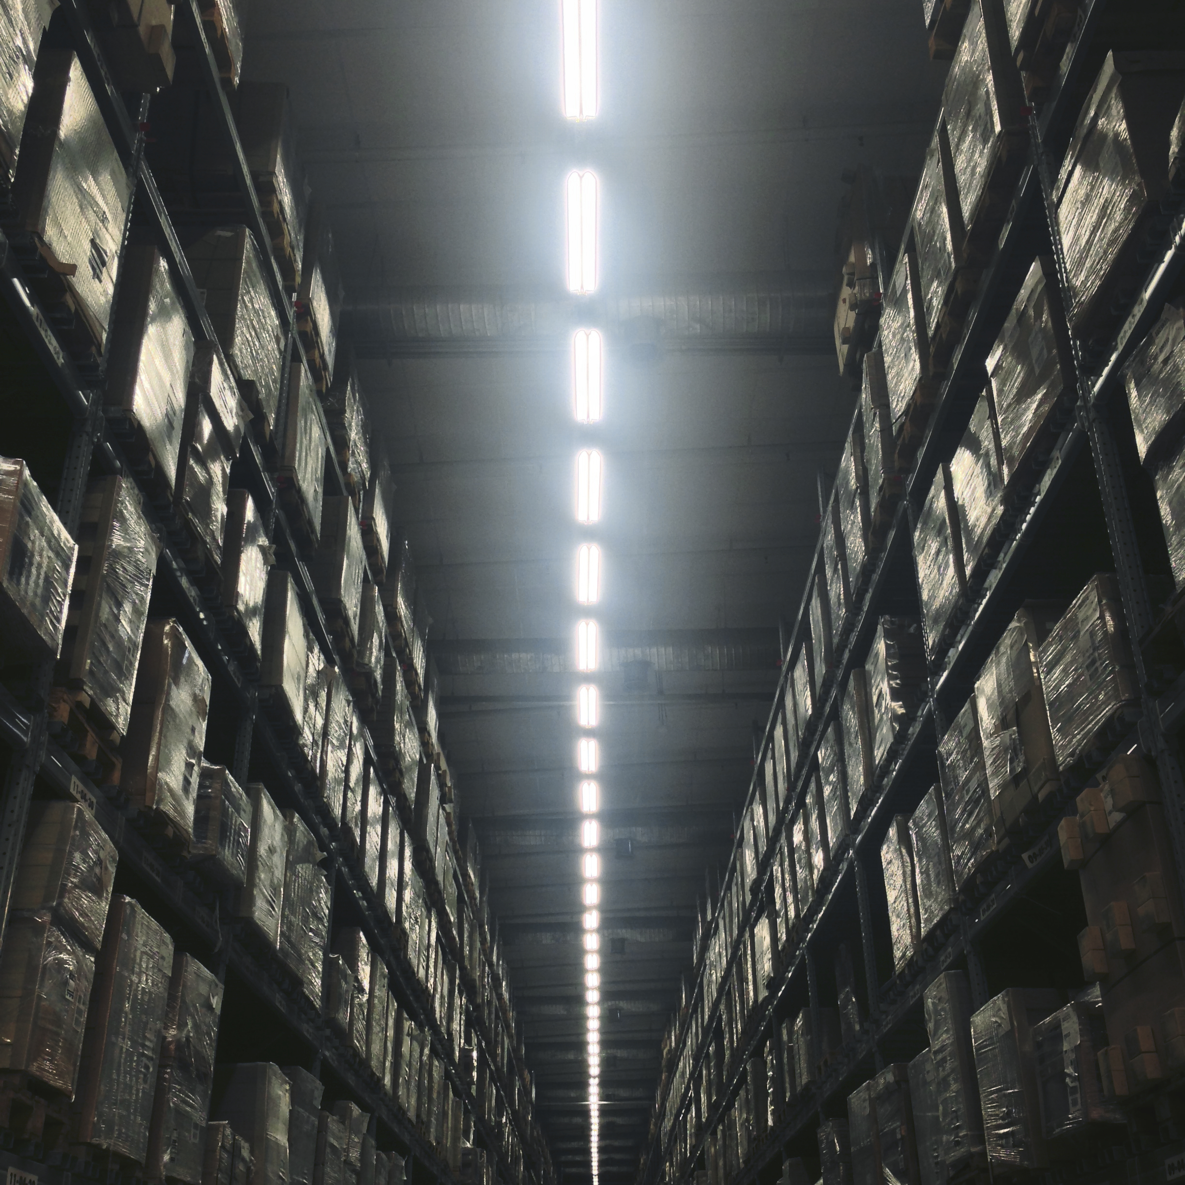


DePaul University
Feb 09, 2025
Recommended Actions 2
Utilize Plant Capacity Fully:
Virginia and Michigan: These plants have extra capacity that is not being used. Shifting some processing here will balance the load and potentially lower costs.
Evaluate Indiana’s Overload:
Since Indiana is handling a major portion of both transportation and processing, redistributing some work to other plants (like Virginia and Michigan) could lower total costs.

Slide 13
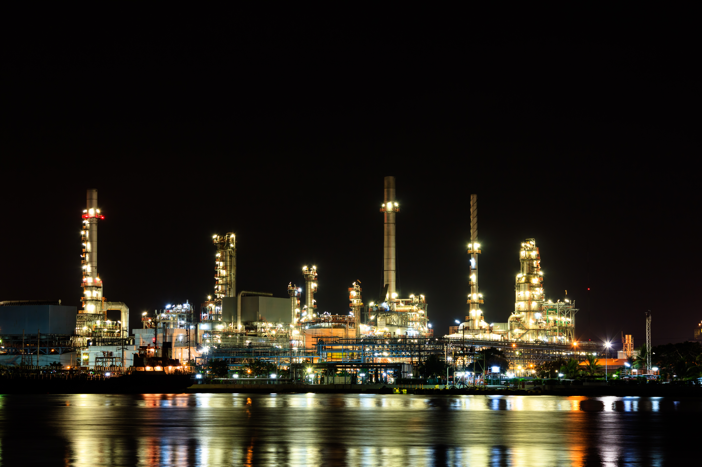
DePaul University
Feb 09, 2025
How Results Support Recommendations 3
Cost Savings: The current total cost is $10.6 million. By redistributing shipments and processing, we can potentially reduce this figure.
Better Capacity Use: Plants like Virginia and Michigan have room for more processing. This allows us to avoid over-relying on Indiana and lowers overall operational strain.
Efficient Transportation: Optimizing transportation routes, especially from Ohio, will help streamline operations and reduce expenses.

Slide 14





DePaul University
Feb 09, 2025
Meet the Team of Walsh
Akash
Sayali
Sudheer
Business Analyst
Operations Manager
Senior Business Analyst
Mayank
Chandhana
Chief Financial Officer
Procurement Manager

Slide 15

DePaul University
Feb 09, 2025
“
Thank You.

